Slide 1
“On the way with Python”

Slide 2
MD. SHAKIL
NSDA Certified Trainer & Assessor
Vendor Certified
IT Specialist in Python
Sr. Backend Developer
Ethical Den
Asst. Trainer
Daffodil International Professional Training Institute
Lead Trainer
eShikhon IT Training Institute
Lead Trainer
Wizard Software & Technology
📞 +88 01793-299882
✉️ shakil.eub.cse@gmail.com
🔗 https://www.linkedin.com/in/mrshakil015
🌐 https://mrshakil.com

Slide 3
Loop in Python
Lecture
07

Slide 4
Introduction
A loop is used to execute a block of code repeatedly as long as a condition is satisfied or for a fixed number of times. Loops help reduce code repetition and make programs efficient.
In Python, loops are mainly of two types:

Slide 5
Why use Loop?
Loops are used to:
Repeat tasks automatically
Process multiple items in a sequence
Reduce code duplication
Perform calculations on large data sets

Slide 6
Types of Loops
In Python, loops are mainly of two types:
Loop
for
while

Slide 7
Python for Loop

Slide 8
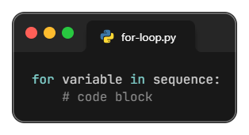
for Loop
With the for loop we can execute a set of statements. for loop used to iterate over a sequence (list, tuple, string, range, etc.).

Slide 9
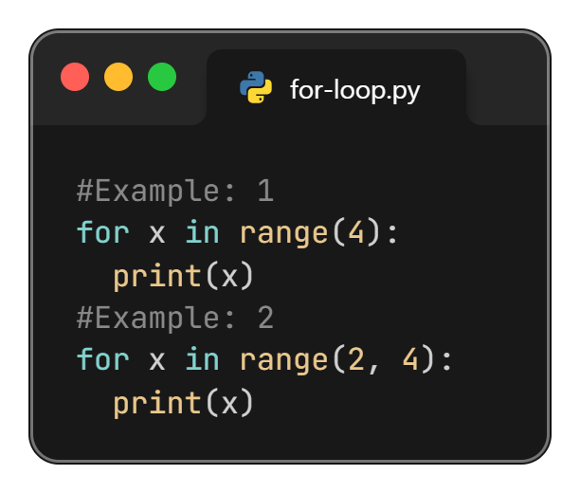
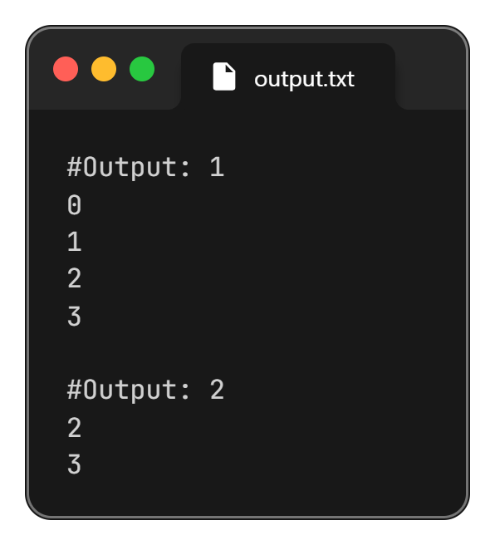
for Loop with Python range()
In Python, the range() function returns a sequence of numbers.

Slide 10
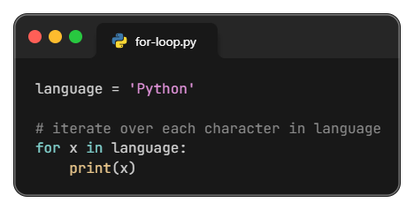
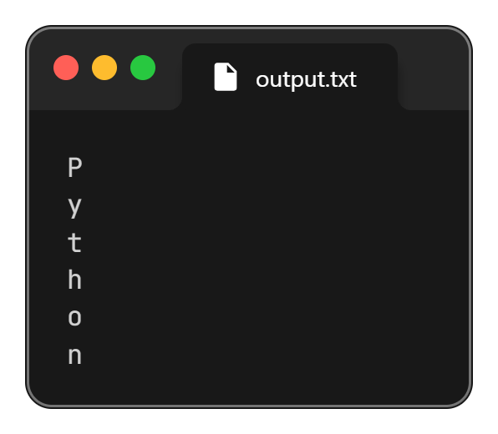
Loop Through a String
Iterate over each character in language

Slide 11
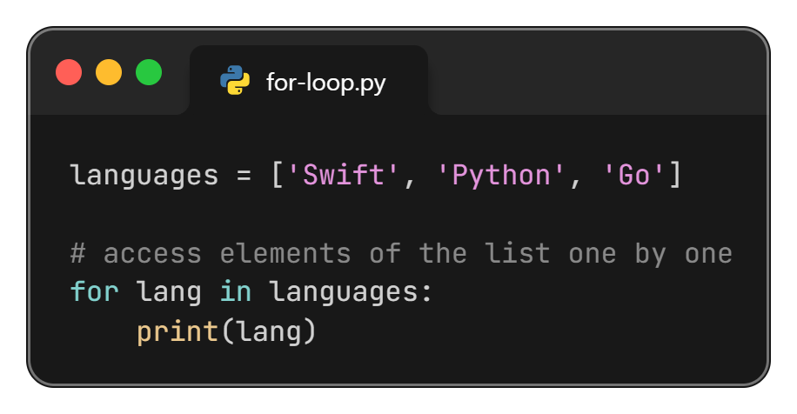
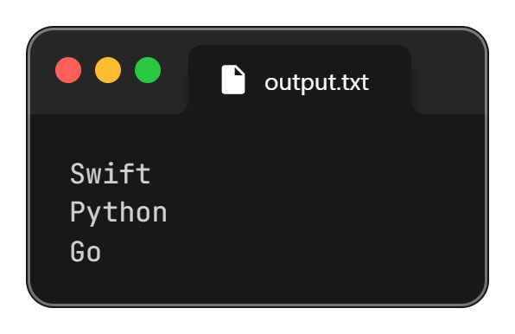
Loop Through a List
Access element of the list one by one.

Slide 12
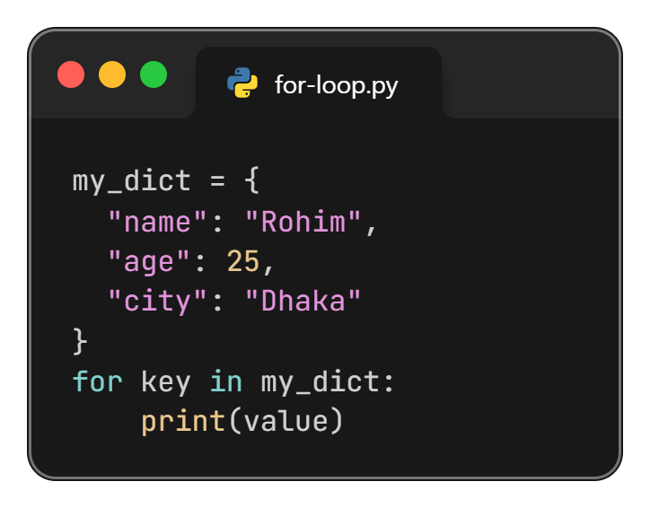
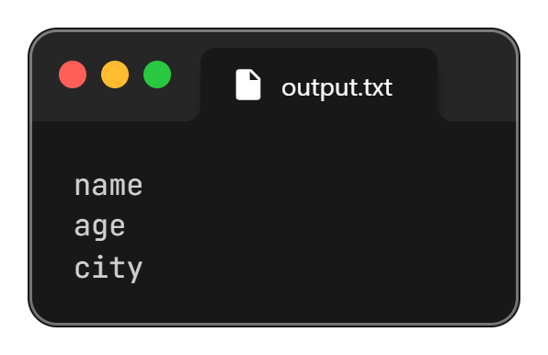
Loop Through a Dictionary
a) Loop Through Keys

Slide 13
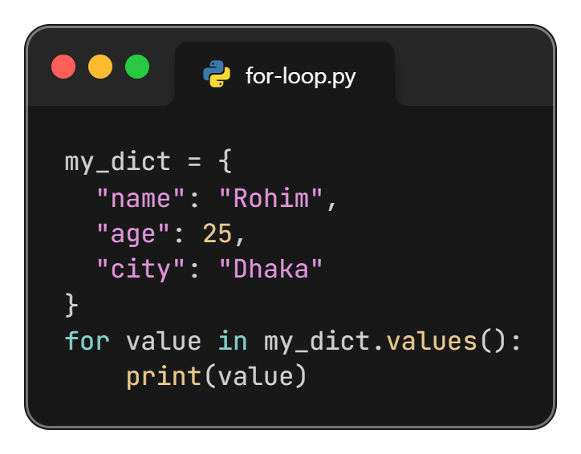
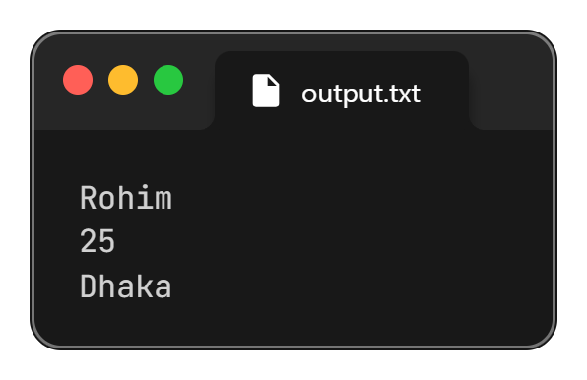
Loop Through a Dictionary
b) Loop Through Values

Slide 14
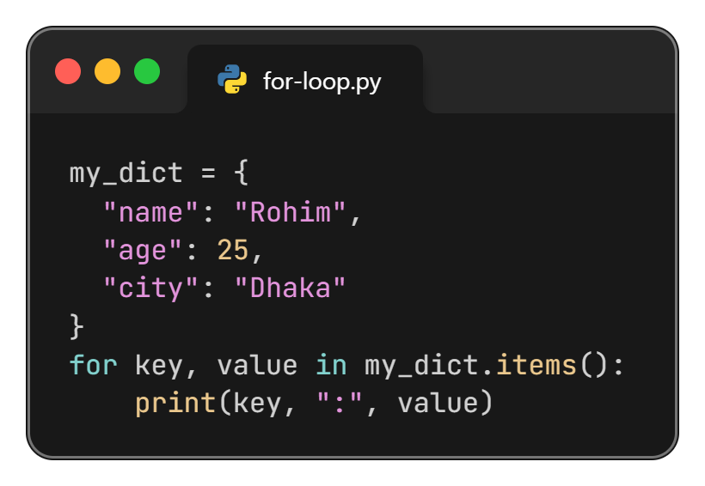
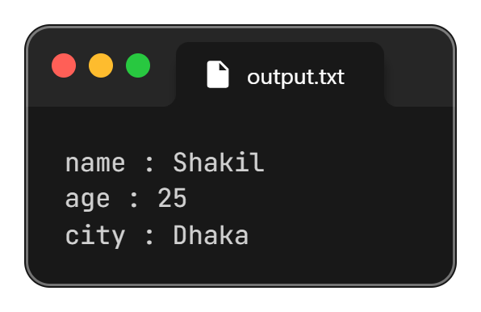
Loop Through a Dictionary
c) Loop Through Key-Value Pair

Slide 15
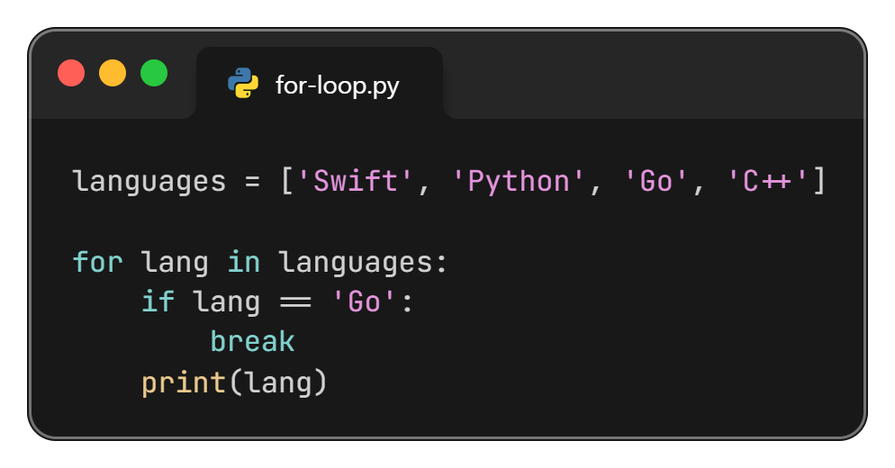
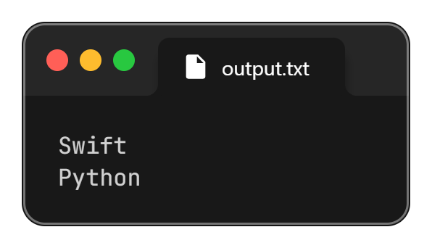
Break Statement
The break statement terminates the for loop immediately before it loops through all the items.

Slide 16
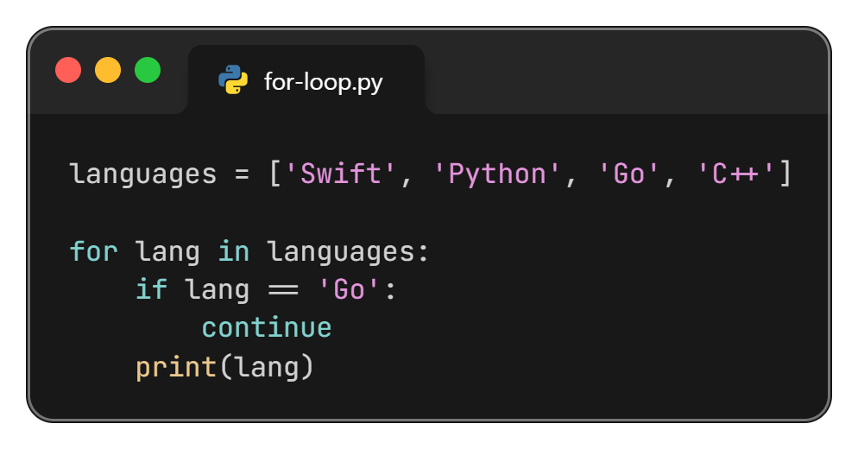

Continue Statement
The continue statement skips the current iteration of the loop and continues with the next iteration.

Slide 17
For Loop Practice Task
Print Odd or Even from a list.
Print Positive or Negative from a list.
Print Odd or Even from a 1 to 20 must be used range.
Sum of the all numbers from a list.
Count how many Odd or Even numbers from 1 to 20
Find the Largest Number from a list.
Print the Multiplication table of number 5.
Sperate Odd and Even number form a list

Slide 18
““Thanks All””

